Slide 1
Module 9 Part 1 Mobile application architecture
Harvinder S Jabbal
SSZG653 Software Architectures

Slide 2
Architecting Mobile applications

Slide 3
Can you give some examples of mobile apps?

Slide 4
Mobile applications
Examples
Uber
Swiggy
Courier delivery
eCom
Banking
Spotify
Where Is My Train
…

Slide 5
Mobile Application: Design considerations
Simple User interface: Easy to type, Large buttons, Minimal features, menu options, actions
Responsive design: Adapt to different screen sizes & orientations
Compact code: Less usage of CPU, memory, storage
Few layers to ensure performance
Connectivity: Store data locally and synchronize later if connection is poor

Slide 6
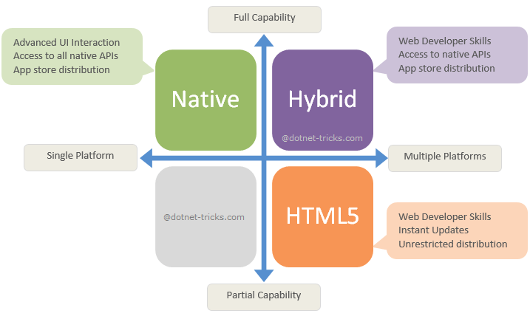
Types of Mobile Apps
Ref: buildfire.com

Slide 7
Mobile Native app
They are built for specific platforms
Examples: Google Maps, Facebook, LinkedIn – one version for iOS and one for Android
Languages used:
Native iOS : Swift or Objective-C
Native Android: Java or Kotlin
Integrated Development Environment (IDE) such as Android studio are used for this

Slide 8
Mobile Web apps
Progressive web apps use modern web technology to deliver app-like experiences to users, right in their browsers.
Examples:
Flipkart
BookMyShow
MakeMyTrip
Uses HTML5, CSS3, JavaScript and runs on a browser

Slide 9
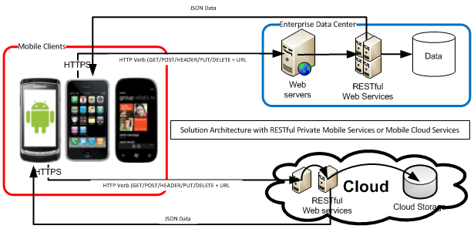
Mobile web application

Slide 10
Hybrid app
A hybrid app combines elements of both native apps and web applications.
Examples: Twitter, Uber, Instagram
Hybrid apps are essentially web apps (HTML, CSS, Javascript) that have been put in a native app shell.
The shell is able to connect to native capabilities of the mobile platform such as camera, accelerometer, GPS, etc.
Tools such as Xamarin and React Native allows app to run across platforms

Slide 11
Pros & Cons
App type | Pro | Con
Native | High performance Superior user experience Access to all features of OS | Runs only on one platform Need to know special language Need to update versions
Web App | Easy to deploy new versions Common code base | Little scope to use device hardware Lower user experience Need to search for app
Hybrid | Does not need browser Single code base Access to device hardware | Slower

Slide 12
UI design patterns
Action bars for quick access to frequently used actions
Login using Facebook, Google, etc. instead of separate user id / password
Large buttons for ease of use
Notifications of recent activity
Discoverable controls: Controls show up only when an item is selected (ex. In WhatsApp, the Forward button shows up when a message is selected)

Slide 13
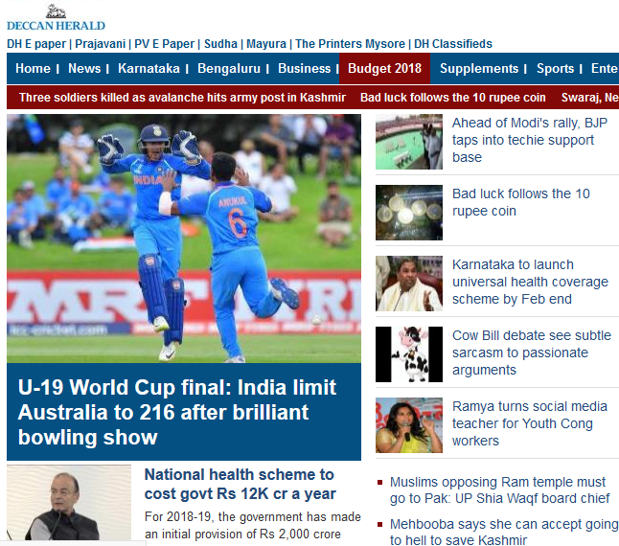
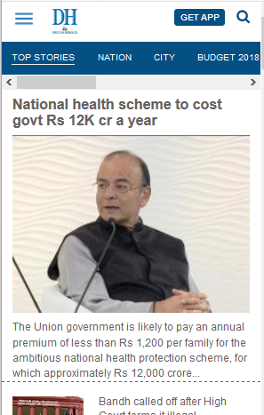
Mobile optimized web site
All features
Reduced features

Slide 14
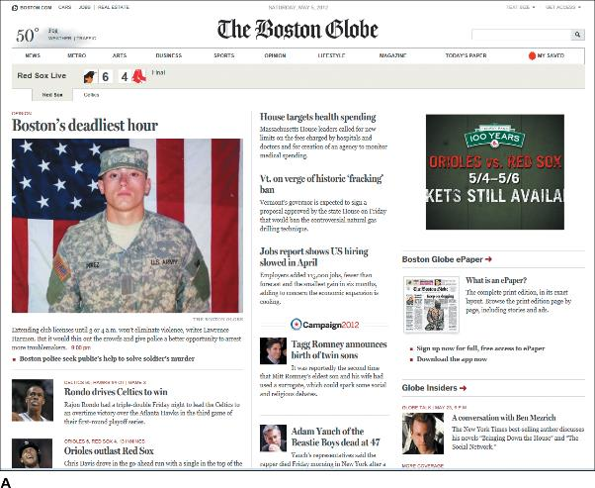
Responsive design
Example: Boston Globe News
This is how the display looks on desktop

Slide 15
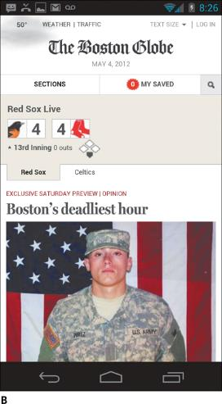
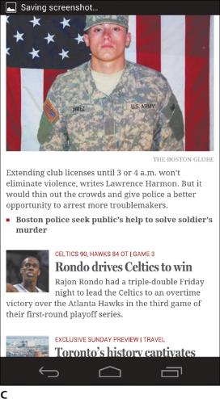
Responsive design
Example: Boston Globe News
This is how the display looks on mobile
Adjusted vertically

Slide 16
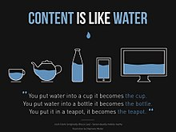
Responsive design
Single website for laptop & mobile & tablet
Principle: Adapt rendering depending on screen sizes & orientation
Ref: Wikipedia

Slide 17
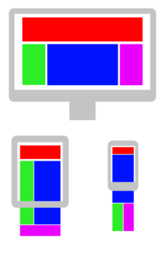
Responsive design
Ref: Wikipedia
Flexi grids
Divide a screen into multiple columns
Assign HTML elements to one or more columns
Choose a different layout depending on screen size

Slide 18
Responsive design
Technique
Use CSS and HTML to shrink, hide or move content
Flexible grids (CSS 3)
Use media queries to determine screen size
Specify grid width as % of screen size rather than fixed pixels
Flexible images – Specify image size as % of grid size

Slide 19
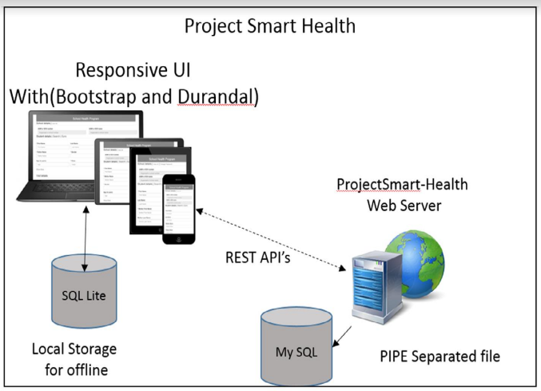
Store locally, Sync later
In case of intermittent connectivity
Doctors enter patient data in mobile, which gets synced with server later

Slide 20
Mobile Application Architecture
Android application architecture
4 types of components
Activity (UI)
Service (background process) - ex. playing music, download
Content provider (Storage) - ex. SQLite, files,
Broadcast receiver (Acts on events received from OS and other apps) - Ex arrival of SMS

Slide 21
Examples of components

Slide 22
Activity & Content providers
Personal Calendar App
<<Activity>>
Appointment list
<<Content Provider>>
SQLite API
DB

Slide 23
(Background) Service
Google Play initiating a download service to download an App
<<Activity>>
Google Play
Server
<<Service>>
Download file
<<Content Provider>>
File API
File

Slide 24

Broadcast receiver (Event handlers)
<<Service>>
Alarm
(Makes sound)
<<Service>>
Call doctor
Doctor’s phone
7
Recorded message
4
5
Get doc details
4
<<Broadcast receiver>>
High Pulse event receiver
<<Broadcast receiver>>
High Pulse event receiver
<<Content Provider>>
File API
High pulse event / intent
Patient monitoring system
3
3
6
<<Service>>
Pulse rate monitor
Config file
(Doc #,
Recorded
msg)
2
1
Pulse monitoring device

Slide 25
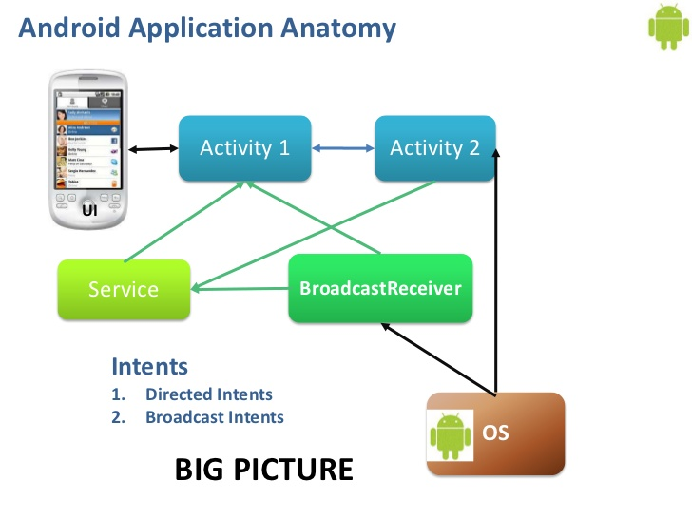
Android application structure

Slide 26
Exercise: Mobile app components
Give examples of mobile app components in Uber app.
UI
Screen to book a cab
Broadcast receiver
Receive location of cab from backend server and provide to UI for display
Service
Provide cab location to backend server after journey starts
Database
Configuration file containing user data

Slide 27
Exercise
Consider a mobile app carried by the courier delivery boy.
The app should support the following functions:
View courier packages to be delivered
Mark a package as delivered.
Upon this event, the app should send information to central server
Identify the components of a mobile app & its inter-connections and draw an appropriate software architecture diagram

Slide 28
Courier boy’s mobile

Slide 29
Courier boy’s mobile

Slide 30
Review questions
Mobile apps
What is a cross platform mobile app?
If connectivity is poor, how do we ensure consistency between data in mobile phone and backend server?
What is ‘Broadcast receiver’ in an Android app?

Slide 31
Mobile - Software Platform
Applications
Framework
Core
Kernel & Device Drivers
Hardware

Slide 32
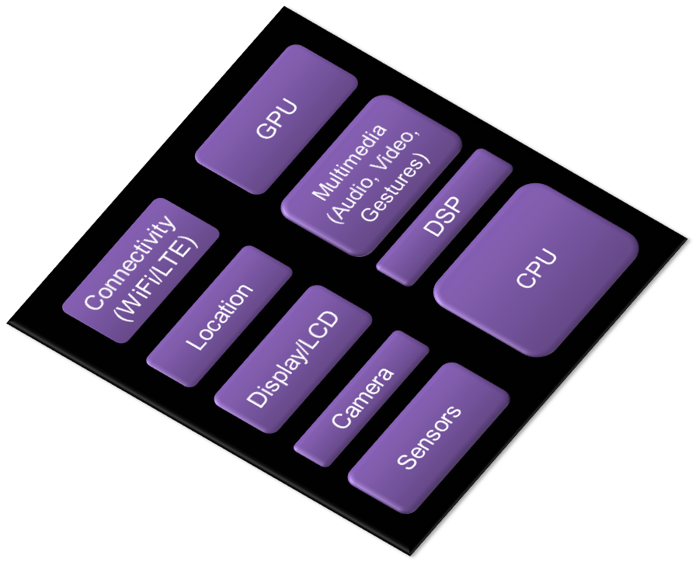
Mobile – Hardware Platform

Slide 33
Typical Software Platform
Native Apps
Web Apps
Native Framework
Web Framework
Core
Kernel & Device Drivers
Hardware

Slide 34
Typical Software Platforms
iOS
Mobile Operating System by Apple
Multitasking
Supports iPhone, iPad and other devices
Windows
Windows Phone OS by Microsoft
Multitasking
Features Metro (Modern UI, Tiled UI)
Android
Google’s Mobile OS based on Linux Kernel
Multitasking
Software Stack
Tizen
An open source standards based platform
Based on Linux, part of the Linux Foundation
OS with Multiple profiles

Slide 35
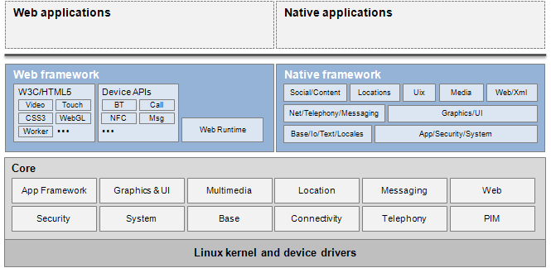
Tizen Architecture

Slide 36
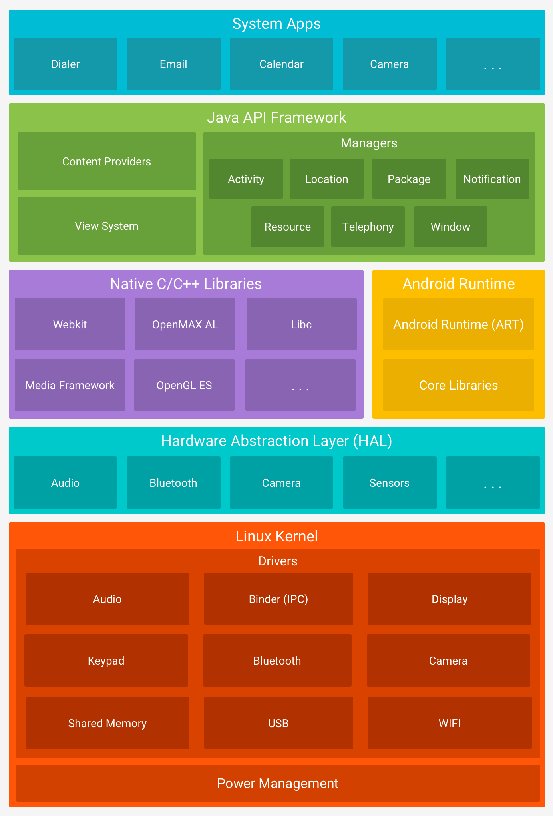
Android Stack

Slide 37
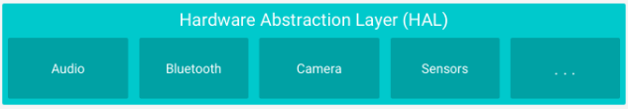
Hardware Abstraction Layer (HAL)
HAL provides standard interfaces that expose device hardware capabilities to the higher-level Java API framework.
The HAL consists of multiple library modules, each of which implements an interface for specific hardware components, such as the camera or BlueTooth module.
When a framework API makes a call to access device hardware, the Android system loads the library module for that hardware component.

Slide 38
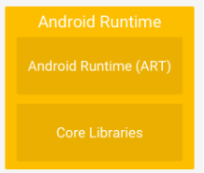
Android Runtime (ART).
Each app runs in its own process and with its own instance of the Android Runtime (ART).
ART is written to run multiple virtual machines on low-memory devices by executing DEX files, a bytecode format designed especially for Android that's optimized for minimal memory footprint.
Android Runtime
Include core libraries and the Dalvik VM
Engine that powers the applications
Forms the basis of the application framework
Dalvik VM is a register-based VM to ensure the device can run multiple instances efficiently

Slide 39
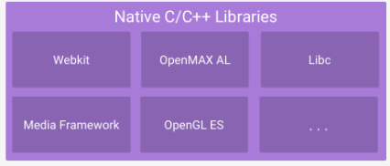
Native C/C++ Libraries
Many core Android system components and services, such as ART and HAL, are built from native code that requires native libraries written in C and C++.
The Android platform provides Java framework APIs to expose the functionality of some of these native libraries to apps

Slide 40
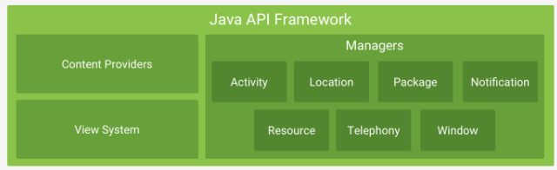
Java API Framework
The entire feature set of the Android OS is available to you through APIs written in the Java language.
These APIs form the building blocks you need to create Android apps by simplifying the reuse of core, modular system components, and services,

Slide 41
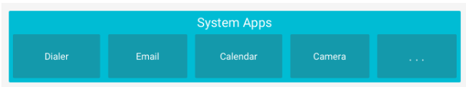
System Apps
Android comes with a set of core apps for email, SMS messaging, calendars, internet browsing, contacts, and more.
Apps included with the platform have no special status among the apps the user chooses to install.
So, a third-party app can become the user's default web browser, SMS messenger, or even the default keyboard (some exceptions apply, such as the system's Settings app).

Slide 42
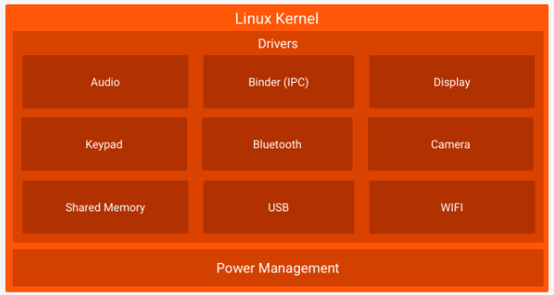
Linux Kernel

Slide 43
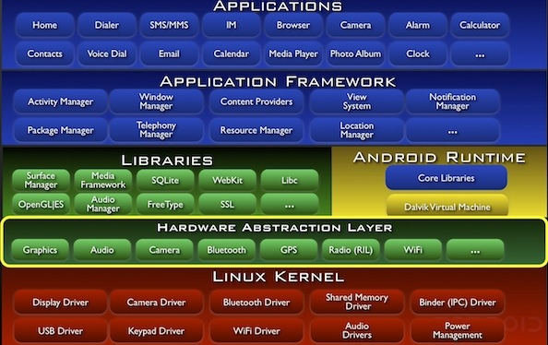
Android Architecture

Slide 44
Popular services of cloud vendors
Google App Engine | Microsoft Azure | Amazon Web Services
Python & Java development environment Auto scaling Database replication | .Net environment Auto scaling Load balancing Failure detection & auto replication of services Database replication | Java development Auto scaling Load balancing Failure detection & auto replication of services Database replication Data caching (Memcached) Service discovery (SoA) Notification of events (SNS) Message queue (SQS) CDN (Content Delivery Network) – YouTube

Slide 45
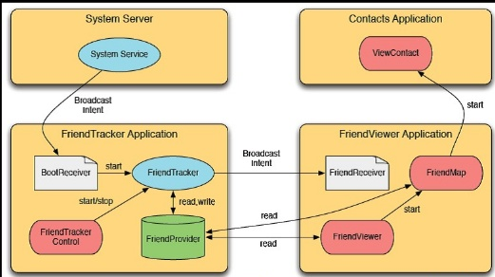
Mobile app: Example
Service
Activity
Asynchronous Task
Database
Intents

Slide 46
Amazon’s approach to handling issues in distributed systems
To scale you have to partition, so you are left with choosing either high consistency or high availability for a particular system. You must find the right overlap of availability and consistency.
Choose a specific approach based on the needs of the service.
For the checkout process you always want to honor requests to add items to a shopping cart because it's revenue producing. In this case you choose high availability. Errors are hidden from the customer and sorted out later.
When a customer submits an order you favor consistency because several services--credit card processing, shipping and handling, reporting--are simultaneously accessing the data.

Slide 47
Issues in Cloud based systems
Availability
Cloud vendors promise high availability ex. 99.95%
But still not 100%
Need to design for the 0.05%
One approach: Store same data in different geographical zones as done by Netflix

Slide 49
Exercise
Scenario
A start-up company is developing a GST tax returns filing system. This software will be deployed on the Cloud and offered to small and medium businesses as a SaaS.
The clients will have to input their data or upload data using an Excel file. They also need to provide other details such as GST #, etc. The software will process the data and file the returns into the Government’s GST system on behalf of the client.
After developing the software, what options exist for deploying it in the cloud?

Slide 50
Different ways to deploy applications on the cloud
Scenario
A start-up company – Tailspin - is developing a customer survey & analysis application. This software will be deployed on the Cloud and offered to clients as a SaaS.
The clients (subscriber of the application) can create and launch a survey.
After this the survey participants will access the application and answer the survey questions.
After the data has been gathered the application will perform analysis and present the results to the client organization
What options exist for Tailspin to deploy the application on the cloud?

Slide 51
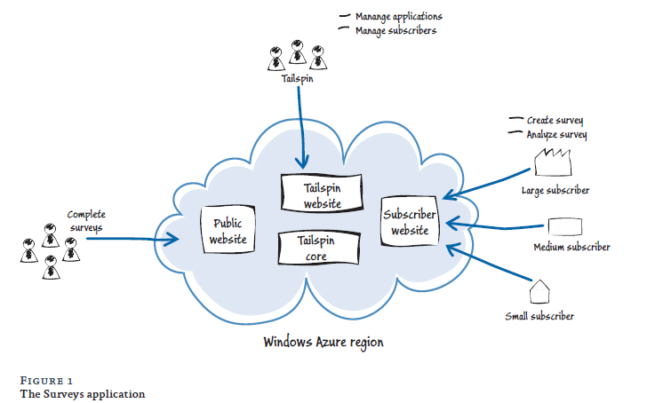
Context diagram

Slide 52
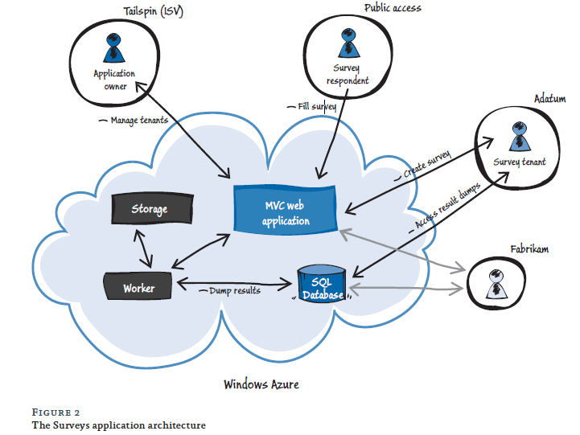
Multi-tenant application Architecture – High level

Slide 53
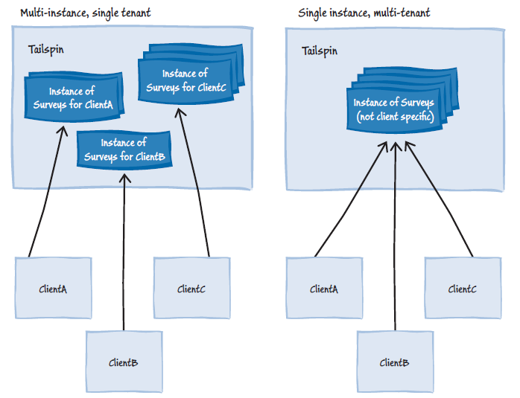
Architecture Options – High level

Slide 54
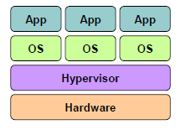
Issues in Cloud based systems
Security issue due to multi-tenancy
Poor design leading to inadvertent sharing of information
Virtual machine ‘Escape’
Other fields of the table |  |  |  |  | OU_ID
 |  |  |  |  | Org1
 |  |  |  |  | Org1
 |  |  |  |  | Org1
 |  |  |  |  | Org2
 |  |  |  |  | Org2
Same table contains data of different organizations
Virtual machine ‘Escape’

Slide 55
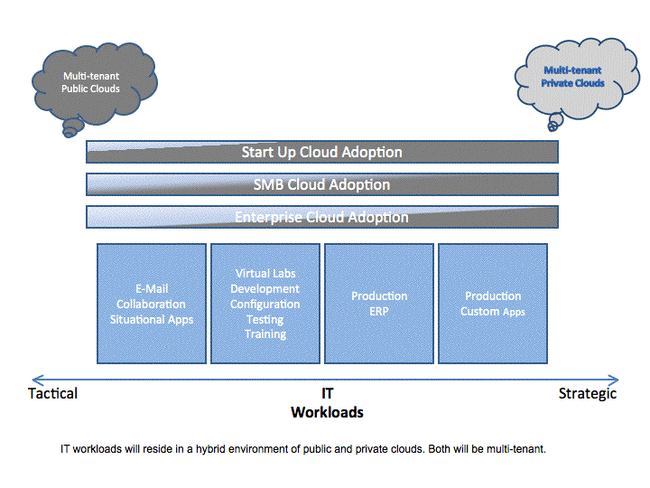
How to choose your multi-tenancy degree?
https://www.computerworld.com/article/2517005/data-center/multi-tenancy-in-the-cloud--why-it-matters.html

Slide 56
How to choose your multi-tenancy degree?
The characteristics of the workload in question have to be carefully studied first, including the workload's utilitarian versus strategic value, volatility, security, etc.
Higher degrees of multi-tenancy are best suited for cross-industry utilitarian workloads such as e-mail, expense reporting, travel authorization and sales force management.
These applications can very easily share the same schema.
https://www.computerworld.com/article/2517005/data-center/multi-tenancy-in-the-cloud--why-it-matters.html

Slide 57
Degree of multi-tenancy
Highest degree: IaaS and PaaS are multi-tenant. SaaS is fully multi-tenant also.
Middle degree: IaaS and PaaS are multi-tenant. Small SaaS clusters are multi-tenant.
Lowest degree: IaaS and PaaS are multi-tenant. SaaS is single tenant.

Slide 58
‘Cloud Native’ applications
Cloud-native computing takes advantage of many modern techniques, including
PaaS,
multicloud,
microservices,
agile methodology,
containers,
CI/CD, and
devops
Reference: https://www.infoworld.com/article/3281046/what-is-cloud-native-the-modern-way-to-develop-software.html

Slide 59
Exercise
When would you use the following options:
a) App 1
Web tier – Multi-tenant
App tier – Single tenant
Data tier – Multi-tenant
b) App 2
Web tier – Single tenant
App tier – Multi-tenant
Data tier – Single tenant

Slide 60
Exercise
When would you use the following options:
a) App 1
Web tier – Multi-tenant
App tier – Single tenant
Data tier – Multi-tenant
Answer: Web tier processing is light, App processing is heavy, data is not confidential
b) App 2
Web tier – Single tenant
App tier – Multi-tenant
Data tier – Single tenant
Answer: Web tier processing is heavy, App processing is light, data is confidential

Slide 61
Mobile Application Architecture
Types of mobile apps | Characteristics
Native app | Makes use of OS and native devices. Ex. Games
Cross platform app | Same code runs on multiple mobile platforms such as Android and iOS
Mobile web application | Has a mobile component which interacts with a server component. Ex. Uber, PayTM, Banking

Slide 62
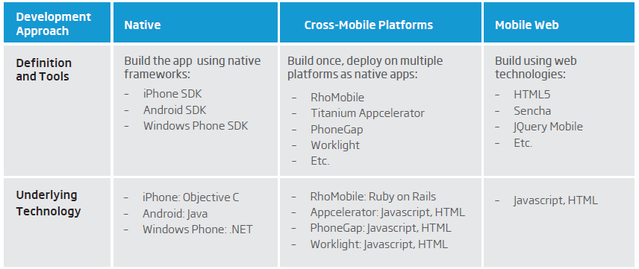
Tools and technology for mobile app development
Xamarin – cross platform tool

Slide 63
Thank you

